Slide 1
PRESENTATION ON ALGORITHM DEVELOPMENT, CONTROL STRUCTURES BASED ON RECURSIVE PROGRAMING USING THE KNOWLEDGE OF MATLAB MODULES 1-5
By Group 18

Slide 2
Details of Group 18 Members
 | NAME | REG NUMBER | PROGRAM
1 | AUMA DIANA | BU/UP/2024/1020 | WAR
2 | ENAMU REAGAN EGIMU | BU/UG/2024/2672 | APE
3 | MUKHOOLI ELIJAH | BU/UG/2024/2586 | MEB
4 | NABAWEESI CLAIRE | BU/UP/2024/1046 | WAR
5 | NAKAWEESA LINNET | BU/UP/2024/4327 | APE
6 | NANDAULA CATHERINE | BU/UP/2024/4322 | AMI
7 | OLUK CHRISTIAN GLEN | BU/UP/2024/3842 | WAR
8 | OMARA PASCAL KELLY | BU/UP/2024/1063 | WAR
9 | TUMUHAISE SARAH | BU/UG/2024/2674 | AMI
10 | UHURU DENISH BRIAN | BU/UP/2024/3841 | WAR

Slide 3
TASK GIVEN
From the assignment of numerical method make an equivalent code based on recursive programing

Slide 4

Solution to the question
Here is the question we are trying to solve using Newton’s Raphson method, secant method, Bisection method and then fixed iteration based on recursive programing.
Solve $x^{3}−5x+3=0$

Slide 5
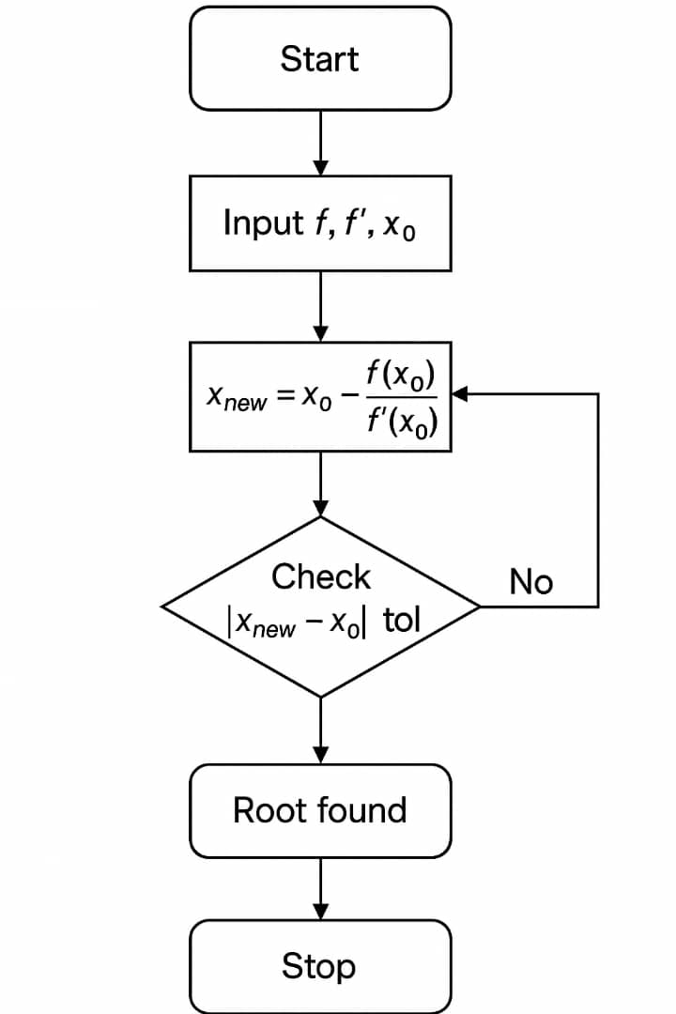
Flow chart for Newton Raphson method

Slide 6
Pseudo Codes for the flow Chart
FUNCTION NewtonRecursive(f, f', x0, tol, maxIter)
IF maxIter == 0 THEN
RETURN x0
ENDIF
x1 = x0 - f(x0) / f'(x0)
IF |x1 - x0| < tol THEN
RETURN x1
ELSE
RETURN NewtonRecursive(f, f', x1, tol, maxIter - 1)
ENDIF
END FUNCTION

Slide 7
Codes used
function root = recursiveNewton(f, df, x0, tol, maxIter)
if maxIter == 0
root = x0;
return
end
x1 = x0 - f(x0)/df(x0);
if abs(x1 - x0) < tol
root = x1;
return
else
root = recursiveNewton(f, df, x1, tol, maxIter - 1);
end
end
f = @(x) x.^3 - x - 2;
df = @(x) 3*x.^2 - 1;
root = recursiveNewton(f, df, 1.5, 1e-6, 50);
fprintf('Recursive Newton-Raphson Root: %.6f\n', root);

Slide 8

Code description
$x_{n+1}=x_{n}−\frac{f_{(xn)}}{{f′}_{(xn)}}$
f(x) is your function.
df(x) is its derivative.
You start with an initial guess x0.
Each iteration improves the estimate using the slope at that point.
The process stops when the change between iterations is very small (tol) or the maximum number of iterations is reached.

Slide 9
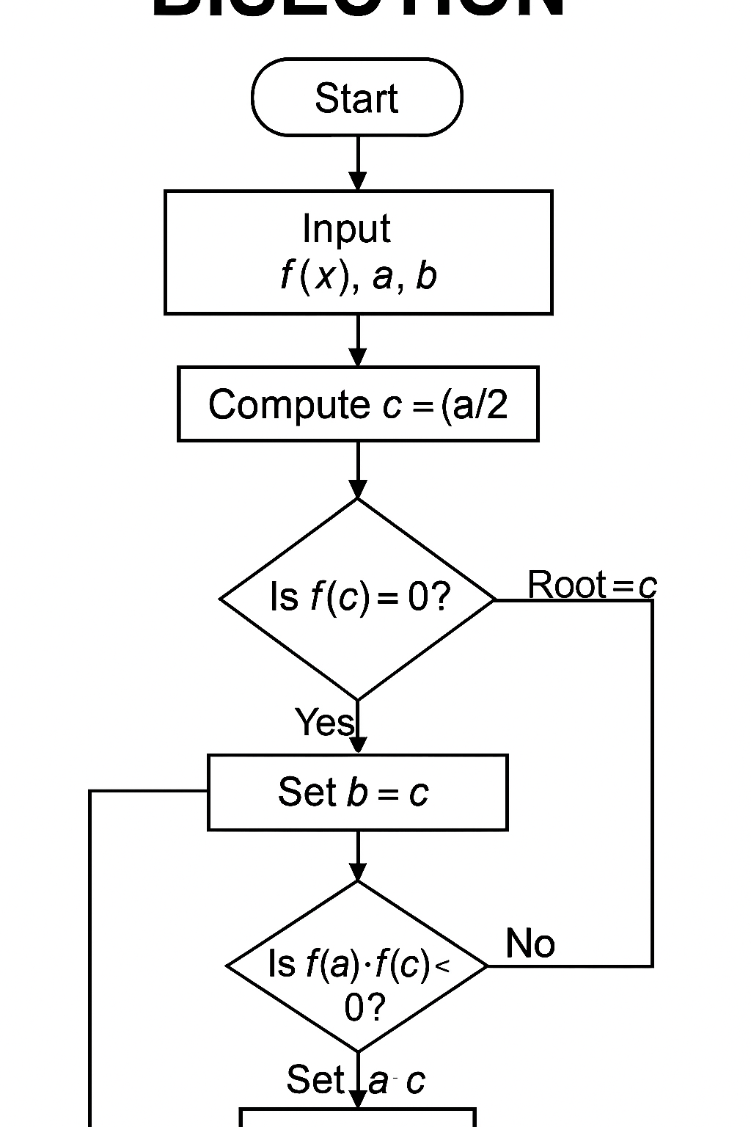
Bisection method flow chart

Slide 10
Pseudo code
FUNCTION BisectionRecursive(f, a, b, tol, maxIter)
IF maxIter == 0 OR |b - a| < tol THEN
RETURN (a + b)/2
ENDIF
c = (a + b)/2
IF f(a)*f(c) < 0 THEN
RETURN BisectionRecursive(f, a, c, tol, maxIter - 1)
ELSE
RETURN BisectionRecursive(f, c, b, tol, maxIter - 1)
ENDIF
END FUNCTION

Slide 11
Actual code used
function root = recursiveBisection(f, a, b, tol, maxIter)
if maxIter == 0 || abs(b - a) < tol
root = (a + b)/2;
return;
end
c = (a + b)/2;
if f(a)*f(c) < 0
root = recursiveBisection(f, a, c, tol, maxIter - 1);
else
root = recursiveBisection(f, c, b, tol, maxIter - 1);
end
end
f = @(x) x.^3 - x - 2;
root = recursiveBisection(f, 1, 2, 1e-6, 50);
fprintf('Recursive Bisection Root: %.6f\n', root);

Slide 12
Concept and code description
The method repeatedly halves an interval [a, b] that contains a root.
Checks if initial interval is valid (sign change).
Repeatedly divides the interval until the difference between a and b is smaller than tol.
The midpoint c becomes the approximate root.

Slide 13
Recursive codes
Instead of looping, the function keeps calling itself with smaller intervals until the root is found or iteration limit is reached.

Slide 14
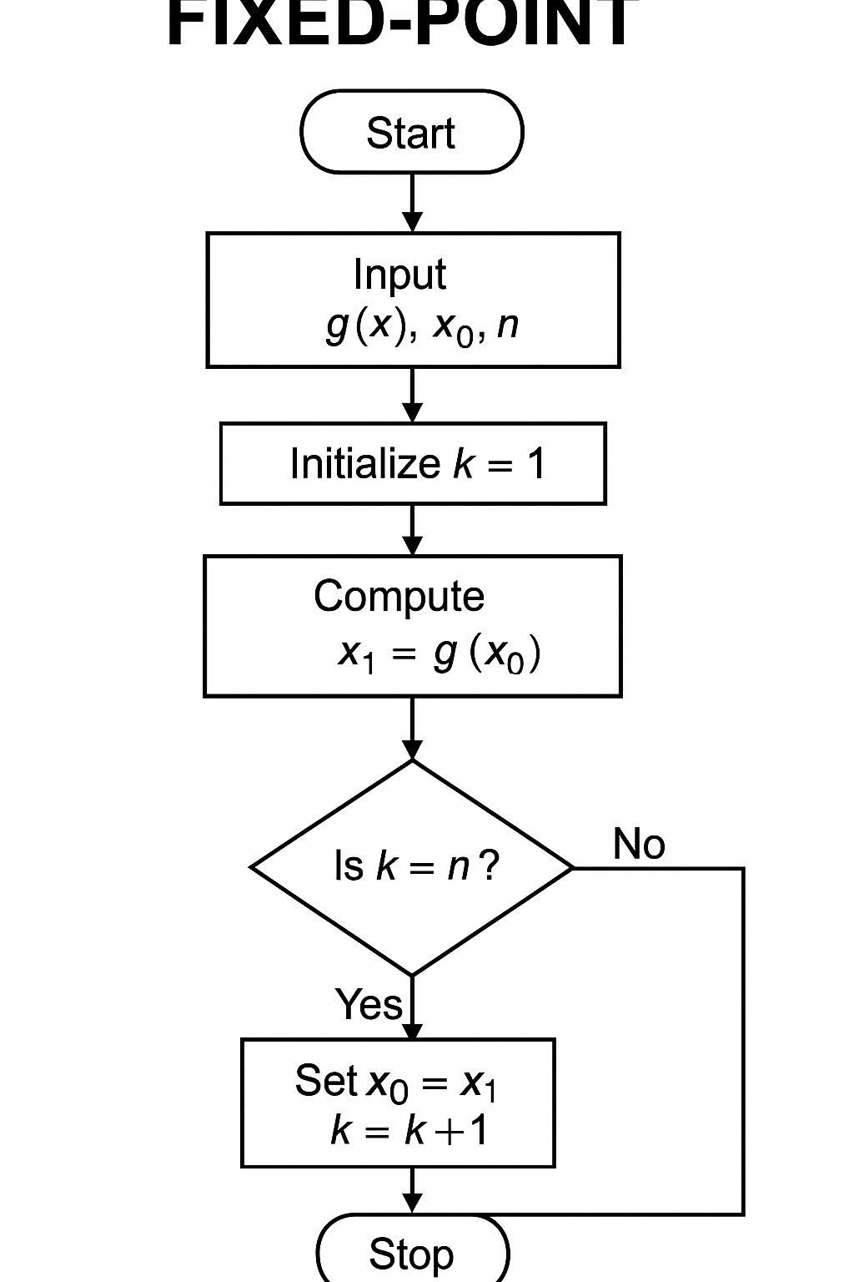
Fixed iteration method flow chart

Slide 15
Pseudo code
FUNCTION FixedPointRecursive(g, x0, tol, maxIter)
IF maxIter == 0 THEN
RETURN x0
ENDIF
x1 = g(x0)
IF |x1 - x0| < tol THEN
RETURN x1
ELSE
RETURN FixedPointRecursive(g, x1, tol, maxIter - 1)
ENDIF
END FUNCTION

Slide 16
Actual code used
function root = recursiveFixedPoint(g, x0, tol, maxIter)
if maxIter == 0
root = x0;
return;
end
x1 = g(x0);
if abs(x1 - x0) < tol
root = x1;
return;
else
root = recursiveFixedPoint(g, x1, tol, maxIter - 1);
end
end
g = @(x) (x + 2).^(1/3);
root = recursiveFixedPoint(g, 1.5, 1e-6, 50);
fprintf('Recursive Fixed Point Root: %.6f\n', root);

Slide 17
Code description
Start from an initial guess x0.
Keep updating with x1 = g(x0) until the values converge.
Works only if ∣g′(x)∣<1|g'(x)| < 1∣g′(x)∣<1 in the region of interest (ensures convergence).

Slide 18
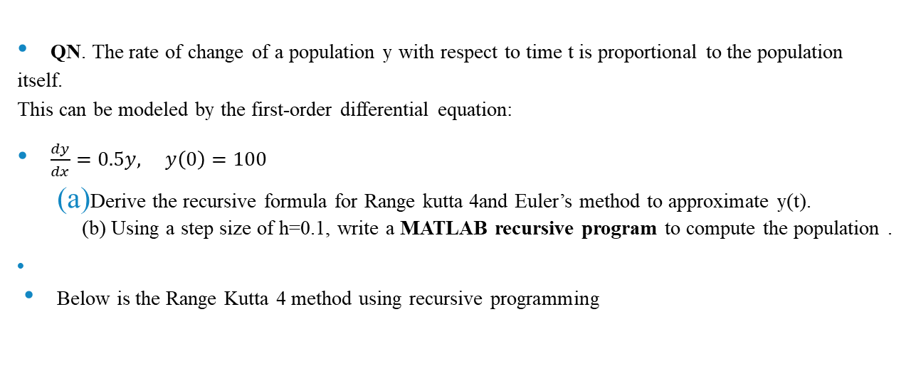
Continuation of recursive codes
QN. The rate of change of a population y with respect to time t is proportional to the population itself. This can be modeled by the first-order differential equation:
$\frac{dy}{dx}=0.5y, y\left(0\right)=100$
Derive the recursive formula for Range kutta 4and Euler’s method to approximate y(t). (b) Using a step size of h=0.1, write a MATLAB recursive program to compute the population .
Below is the Range Kutta 4 method using recursive programming

Slide 19
Continuation of recursive codes
% Runge-Kutta 4th Order (Recursive)
r = 0.5;
y0 = 100;
t0 = 0; tf = 10; h = 0.1;
t = t0:h:tf;
y = rk4_recursive(r, y0, t, h, 1);
y_exact = y0 * exp(r*t);
% Recursive Function
function y = rk4_recursive(r, y0, t, h, i)
y = zeros(size(t));
y(i) = y0;
if i == length(t)
return;
else
k1 = r*y0;
k2 = r*(y0 + 0.5*h*k1);
k3 = r*(y0 + 0.5*h*k2);
k4 = r*(y0 + h*k3);
y_next = y0 + (h/6)*(k1 + 2*k2 + 2*k3 + k4);
y_rest = rk4_recursive(r, y_next, t, h, i + 1);
y(1:i) = y0;
y(i+1:end) = y_rest(i+1:end);
end
end

Slide 20
% Euler's Method (Recursive)
r = 0.5;
y0 = 100;
t0 = 0; tf = 10; h = 0.1;
t = t0:h:tf;
y = euler_recursive(r, y0, t, h, 1);
y_exact = y0 * exp(r*t);
% Recursive Function
function y = euler_recursive(r, y0, t, h, i)
y = zeros(size(t));
y(i) = y0;
if i == length(t)
return;
else
y_next = y0 + h*r*y0;
y_rest = euler_recursive(r, y_next, t, h, i + 1);
y(1:i) = y0;
y(i+1:end) = y_rest(i+1:end);
end
end

Slide 21
Code description
For the Euler’s method loop, we considered the steps below; • Start at initial condition y(0)=y0
• Compute next value using yi+1=y0 + h*r*y0;
• Call the same function again for the next time step (i + 1).
• Continue recursively until the end of the time vector is reached

Slide 22
Solution to second question
Fibonacci Problem
Below is the code showing how to solve Fibonacci Problem using recursive and dynamic approach and its comparison as the graph.

Slide 23
%Recursive approach
function f = fib_recursive(n)
if n <= 1
f = n;
else
f = fib_recursive(n-1) + fib_recursive(n-2);
end
end
%Dynamic approach
function f = fib_dynamic(n)
fib = zeros(1, n+1);
fib(1) = 0; fib(2) = 1;
for i = 3:n+1
fib(i) = fib(i-1) + fib(i-2);
end
f = fib(n+1);
end
N = 5:30;
time_rec = zeros(size(N));
time_dyn = zeros(size(N));
for i = 1:length(N)
tic; fib_recursive(N(i)); time_rec(i) = toc;
tic; fib_dynamic(N(i)); time_dyn(i) = toc;
end
plot(N, time_rec, 'r-o', N, time_dyn, 'b:*');
xlabel('n'); ylabel('Time (seconds)');
legend('Recursive', 'Dynamic');
title('Fibonacci Computation Time Comparison');
grid on;

Slide 24
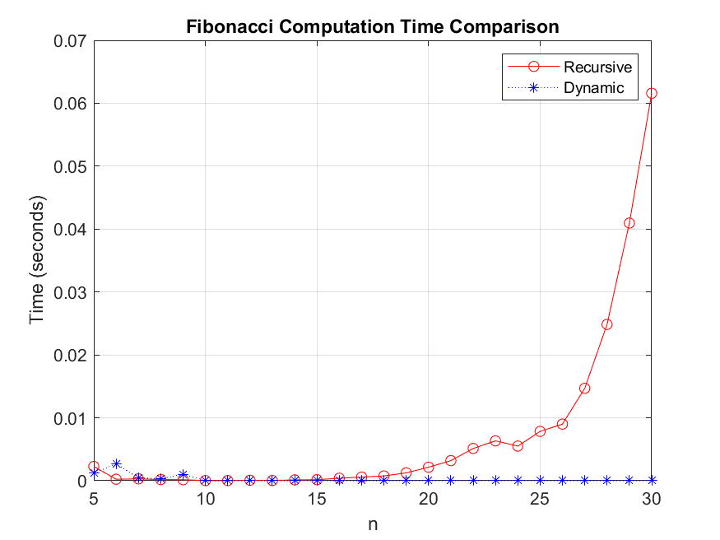

Slide 25
The graph above shows a graph comparing the recursive approach and dynamic approach in terms of time against n, where n is the position in the Fibonacci sequence

Slide 26
knapsack problem
Below is the code solving the knapsack problem using recursive approach and dynamic approach and its comparison as time.

Slide 27
%Recursive approach
function val = knapsack_recursive(W, wt, val_arr, n)
if n == 0 || W == 0
val = 0;
elseif wt(n) > W
val = knapsack_recursive(W, wt, val_arr, n-1);
else
include = val_arr(n) + knapsack_recursive(W - wt(n), wt, val_arr, n-1);
exclude = knapsack_recursive(W, wt, val_arr, n-1);
val = max(include, exclude);
end
end
%Dynamic approach
function val = knapsack_dynamic(W, wt, val_arr)
n = length(val_arr);
K = zeros(n+1, W+1);
for i = 1:n+1
for w = 1:W+1
if i == 1 || w == 1
K(i, w) = 0;
elseif wt(i-1) <= w-1
K(i, w) = max(val_arr(i-1) + K(i-1, w-wt(i-1)), K(i-1, w));
else
K(i, w) = K(i-1, w);
end
end
end
val = K(n+1, W+1);
end
W = 10;
wt = [2, 3, 4, 5];
val_arr = [3, 4, 5, 6];
N = length(val_arr);
tic; r = knapsack_recursive(W, wt, val_arr, N); t1 = toc;
tic; d = knapsack_dynamic(W, wt, val_arr); t2 = toc;
fprintf('Recursive value: %d, time = %.6f s\n', r, t1);
fprintf('Dynamic value: %d, time = %.6f s\n', d, t2);

Slide 28
CONCLUSION;
By the end of the assignment, we were able to know that recursive programming provides a simple way of solving different mathematical equations and the associated problems in the daily life. We also found out the dynamic programming is simplifies the understanding especially in practical computations by solving different mathematical problems such as Fibonacci and knapsack problems.

